Slide 1


THE BOEING MISHAP
A Case Study by Team Meraki
UTSAV | AASHRITH | ARYA

Slide 2
“Two of Boeing’s 737 Max have crashed recently just a few minutes after take off, taking a total toll of 346 lives”
Let us dive in deeper to see how this has affected the industry

Slide 3

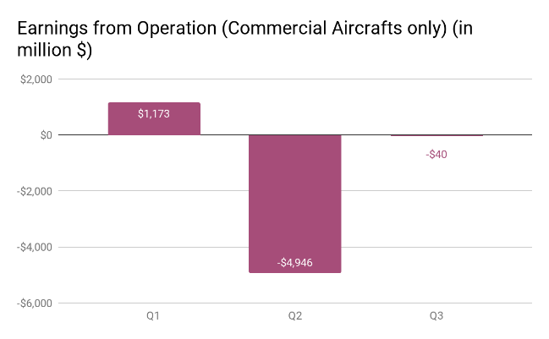
Financial Impact
STRATEGIC IMPACT
Boeing suffered a loss of close to $3 billion in Q2 of 2019
Net loss for the first quarter of operations since 737 MAX commercial flights were halted was $2.94 billion compared to a profit of $2.20 billion in the previous year
Total sales slipped down by 35% to $15.75 billions, below the average expectation of $18.55 billions.
With the goal of doubling profitability, 3 years ago Boeing started improving their productivity for accelerated output, which is the major reason for faulty manufacturing.
The Max 737 will be on probation list with consumers after it returns to service.
Although profit margin drop is expected to be temporary, it will certainly shift bargaining leverage to customers on this aircraft.
Team Meraki

Slide 4
COMPETITION DYNAMICS – POST GROUNDING
PARIS
AIRSHOW
In the Paris Air Show 2019, Airbus received orders for 595 aircrafts as compared to Boeing’s 234 orders. This is a contrasting outcome when compared to Paris Air Show 2017, where Boeing received 587 orders(most of them being 737 MAX) as compared to Airbus’ mere 217. This indicates the heavy effect of 737 MAX groundings on Boeing.
The aviation market is globally dominated by the closely fought rivalry of Boeing and Airbus.
In the aviation market, the narrow-body aircraft segment is the most competitive segment, dominated by Boeing’s 737 line and Airbus’ A320 and A220 families.
The 737 MAX is Boeing’s most popular and highest selling aircraft. The grounding of 737 MAX aircrafts has created a void in the aviation market and a potential opportunity for Airbus to take an upper hand.
GROWING
MARKETS
Indonesia’s Garuda Airlines cancelled 49 orders, while Azerbaijan Airlines cancelled 10. In India, SpiceJet which operates with only Boeing and Bombardier is now considering to order 100 aircrafts from Airbus. This indicates loss of market share in rising markets.
AMERICAN
MARKET
North America has been Boeing’s hunting ground in terms of market share. After the groundings, Spirit Airlines ordered 50 Airbus aircrafts after losing faith in Boeing’s 737 MAX.
SouthWest Airlines which has been operating only on Boeing aircrafts in the past is now considering moving to Airbus
Team Meraki

Slide 5
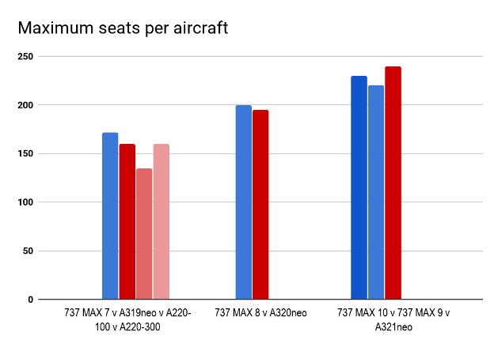
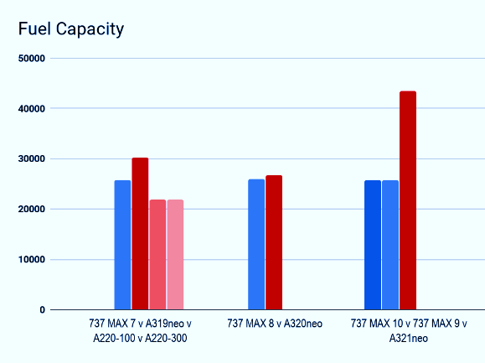
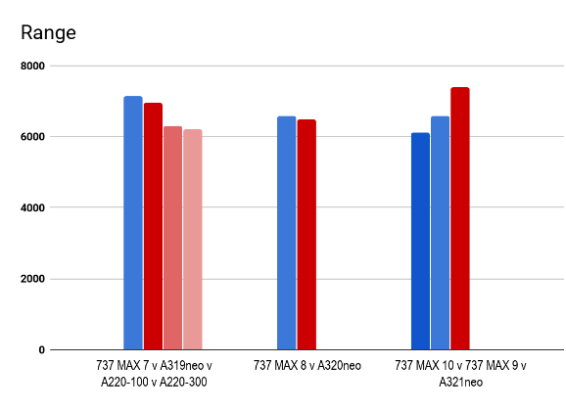
NARROW BODY AIRCRAFT PORTFOLIO COMPARISSION
Boeing’s portfolio is neck-to-neck with that of Airbus in all segments barring the extra capacity, extra long range narrow-body airliners.
Airbus’ A321neo along with the newer A321 XLR is witnessing huge demand serving as the go-to aircraft for small and new operands of long range aircrafts that operate with narrow body aircrafts
Team Meraki

Slide 6

Is Boeing's current portfolio future ready?
Speaking in technological terms, Boeing’s current offerings are just several times iterated traditional aircrafts. There is a need of a major upgrade of technology to meet the future demands in the aviation market. Along with fixing the faults in the 737 MAX, they should also find ways of increasing the range of their narrow – body aircrafts, to compete with the A321XLR
Boeing’s current commercial portfolio consists of the following aircrafts:
Next – Generation 737
737 MAX
747-8
767
777
777X
787
Freighters
Boeing Business Jets (BBJs)
Team Meraki

Slide 7

RE-INTRODUCTION STRATERGY
Drawing comparisons from Samsung’s Note 7 battery debacle, Boeing can regain the trust of its customers and the airline industry by first holding itself accountable for the problems and technical faults.
ACCOUNTABILITY
Boeing must get to the root cause of the problem, take any third party help needed and then effectively communicate the problem along with its proposed solution to its employees and customers.
COMMUNICATION
ACTION
Boeing must hold sessions/workshops to make pilots completely aware of the working of their systems.
Boeing can change the name of their narrow-body aircraft line, using NXG instead of MAX, which would imply as the next generation of the older one. This would bring a sense of change and freshness about the company’s culture in people’s perspectives.
Team Meraki

Slide 8
Market share dynamics in Indian skies
Air India placed orders for more than 68 jets from Boeing for $7.5 billion for expansion
Indian Airlines placed orders for 43 jets from Airbus for $2.5 billion for expansion
Kingfisher Airlines starts operations with Airbus A320 with a deal worth $3 billion.
IndiGo announced orders for 100 Airbus A320s worth $6 billion during the Paris Air show, the highest by any Asia domestic carrier.
SpiceJet starts operations with Boeing 636-800
In Civil Aviation, airline companies choose an aircraft manufacturer over the other when it starts operating or when it considers expansion.
For economic and maintenance reasons, airlines stick with one aircraft manufacturer after the initial deal.
Initial deals and expansion deals showcase competition dynamics between Airbus and Boeing in India.
Contrary to popular opinion, Boeing and Airbus have been equally competitive in the Indian civil aviation history.
With internal and operational failures and problems of Boeing’s Indian customers like Jet Airways, Air India and SpiceJet and huge recent rise of IndiGo(Airbus’ customer), Airbus is threatening to permanently take away majority of the Indian market share
Boeing bags State-run Air India deal over Airbus
Liberalization of Indian Civil Aviation
FDI upto 49% in Indian Civil Aviation
Pre-liberalization Era
1990’s
2003-2006
2007-2017
2017-Present
Jet Airways places $365 million order for four 737-400 and six 737-800
Indian Airlines places order for Airbus’ A320-200’s
AirAsia India, a low-cost carrier operating as a joint venture between Air Asia and Tata Sons and Vistara begin opeartions with Airbus A320-200.
GoAir commences operations with Airbus A320
100% FDI in Indian Civil Aviation
Team Meraki

Slide 9
How can Boeing challenge Airbus in India in the high demand narrow-body segment?
The Indian Commercial Market is completely dominated by Airbus. Out of a total of 669 aircrafts, a massive number of 424 belong to Airbus (A319, A320, A321), followed by 158 of Boeing (737, 777, 787, 747).
The major client in India for Airbus is Indigo and Air India, with Indigo having more than half of the total number.
The major client for Boeing is SpiceJet and Air India, but the numbers are very low.
Boeing must diversify its production process across the globe to cut down maintenance costs for its customers.
Boeing must offer attractive deals by initially bundling more number of aircrafts with a cheaper and competitive price(similar to deal offered to IndiGo by Airbus) to penetrate deeper into the market.
With 100% FDI approved by the Government in Indian Civil Aviation which is expected to give birth to new ventures and expected growth of Indian Air Traffic, there is a huge opportunity for Boeing to capture a part of the Indian Market.
Team Meraki

Slide 10
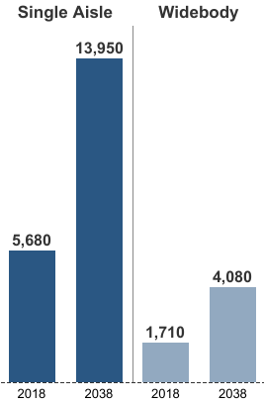
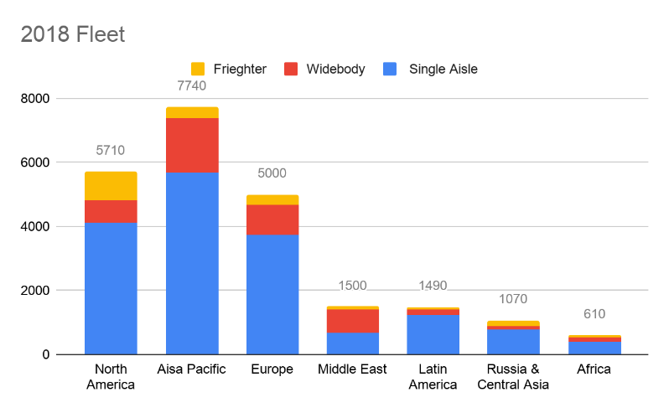
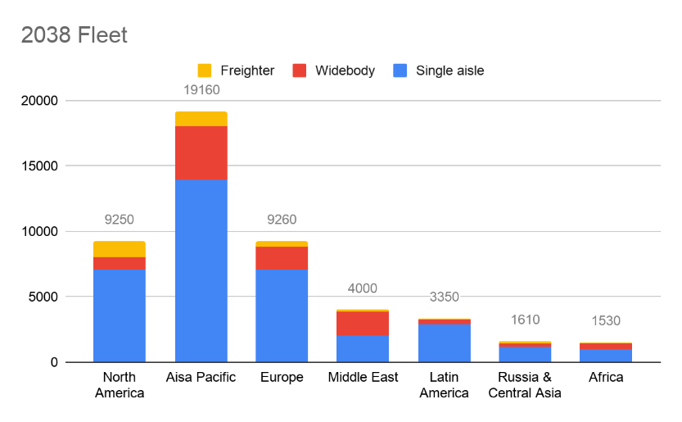
Target markets for the next two decades
ASIA PACIFIC
5.5% average annual air traffic growth over next 20 years.
One quarter of world air travel is flown within Asia itself.
35% of the global air travel will be intra-Asia in the coming 2 decades.
Major potential:
China will need 5,960 single-aisle jets, 1,780 widebody alone.
India would need around 2,400 new aircraft, of which 85-90% would be narrow body, mostly 737 sized aircraft.
Team Meraki

Slide 11
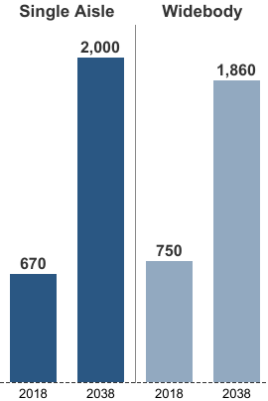
Target markets for the next two decades
MIDDLE EAST
5.1% average annual air traffic growth over next two decades.
The Middle-East represents a $745 billion market potential, growing at 4.6% annually.
Major potential:
Wide-body aircraft fleet is expected to increase by 148% (x2.48)
Team Meraki

Slide 12
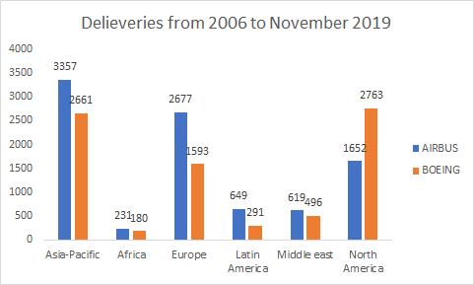
REGION WISE AVIATION MARKET
North America has been dominated by Boeing for a long time, with majority of revenue from US
BOEING DOMINATED MARKETS
North America
Asia Pacific
Middle East
In Middle-east, Africa and Latin America, Airbus faces a stiff competition from Boeing both delivery and revenue wise.
Europe and Asia Pacific are strong markets of Airbus.
SIMILAR MARKET SHARE
AIRBUS DOMINATED MARKETS
Africa
Europe
Latin America
Team Meraki

Slide 13
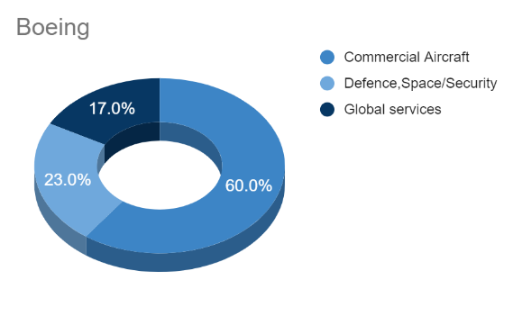
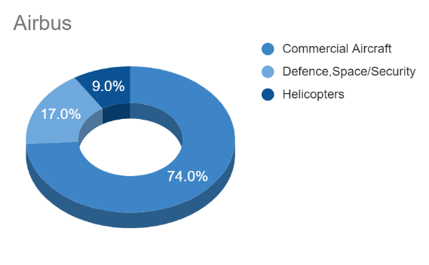
Competitive rivalry between Boeing and airbus
Segmental Revenue:
Airbus is more dependent on civilian aircraft for its revenue, with its commercial and helicopter segments together contributing a majority share of revenue.
Thus, Boeing is better placed to absorb any potential financial shocks of multiple grounding incidents that may affect sales.
Revenue Distribution:
Airbus has a better revenue diversification.
Airbus’s revenue is majorly from high growth potential such as Asia Pacific. especially China, Boeing too recognizes to be a crucial market for its future growth.
Team Meraki

Slide 14
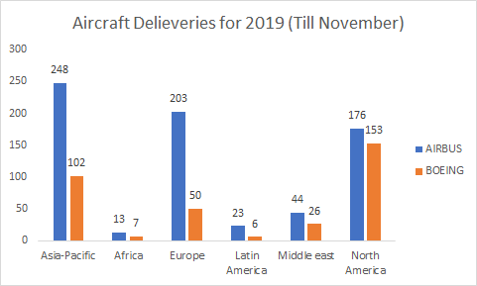
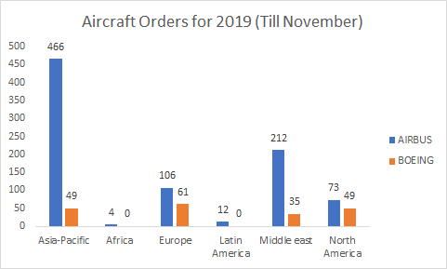
EFFECT OF GROUNDING ON MARKET SHARE
North America was completely dominated by Boeing for a long time, with majority of revenue from US.
Effect of 737 grounding can be seen in north America clearly. However, Boeing can still gain back it’s position here.
In Middle east, Africa and Latin America, Airbus faces a stiff competition from Boeing both delivery and revenue wise.
Europe and Asia Pacific is strong market of Airbus, where it would be very difficult of Boeing to emerge as market leaders.
Team Meraki

Slide 15

Expected rise in demand
WIDE BODY IN DOMESTIC USE
Growth rates show that air passengers will grow internationally and domestically both.
A replacement cycle for a wide body aircraft will start in a year or so.
The new 777x is well positioned to benefit. Also, wide body will see a rise in demand on domestic routes.
Wide body have low operational costs, which will bring down ticket costs, convenient for rising air passengers.
A NEW AIRCRAFT: NARROW BODY LONG HAUL
With launch of A321XLR, Airbus has opened up a whole lot of market which require 9 hours of flying, and earlier used to have the need of flying a widebody aircraft.
For instance, take my home markets, where India to Europe, which is operated by the Boeing 787 by Air India and was operated by a mix of the Boeing 777/Airbus 330 by Jet Airways, can largely be flown with an A321XLR (the range is for a two-cabin configuration, so a bit lesser in a single cabin configuration), avoiding the hassle to change flights for passengers.
Team Meraki

Slide 16
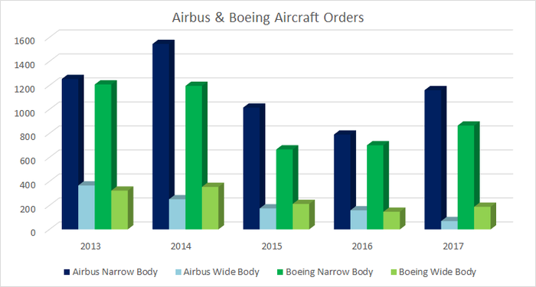
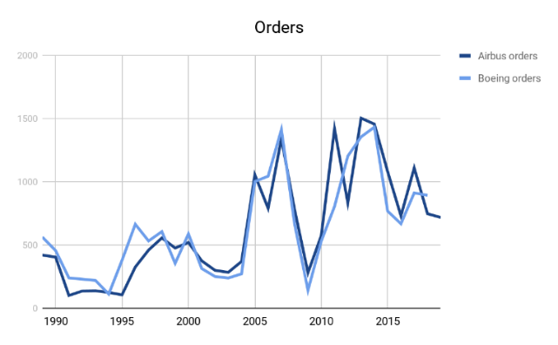
Segmental market share
Narrow body
With a big win for Airbus, when Indian budget carrier IndiGo ordered 300 narrow-body aircraft in a deal worth more than $33 billion, Boeing is losing its market position in this domain.
Shift from North America/Europe to Asia Pacific: There is a urgent need to focus on advancing markets of Asia-Pacific. These areas will constitute more than 45% of the growing market.
Aftermarket revenue : By manufacturing original equipment itself, Boeing can benefit from long-term aftermarket revenue coming from replacement demand.
Wide body
Boeing can gain a second wind only from a combination of increased wide-body demand and ongoing margin expansion.
Sales volume expansion: Chinese airlines have launched more than 30 new long haul routes, which require twin-aisle aircraft.
Team Meraki

Slide 17
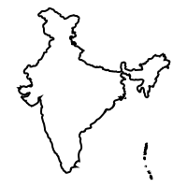
“International routes originating from India have been increasingly served by international airlines”
Let’s find out which regions contribute to the maximum traffic in the Indian Skies.

Slide 18
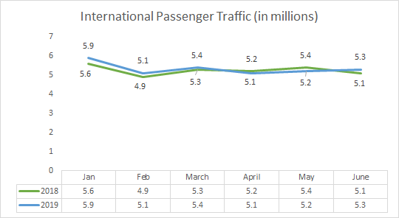
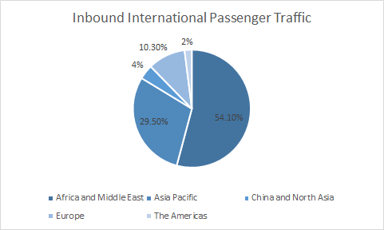
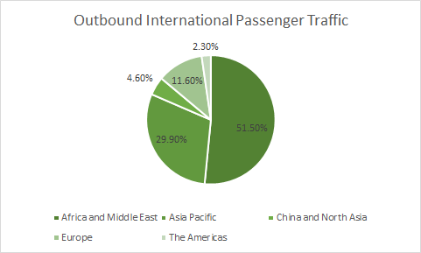
International passenger traffic to and from India
In the 2nd Quarter of 2019, a total 86 international carriers- 6 Indian carriers(6.98%) and 80 foreign carriers(93.02%) have operated to and from India, connecting India with 52 countries operating on 332 routes.
Total passengers carried in the first half of 2018 are 31.5 million, while in 2018, it’s 32 million, a 1.59% increase.
Approximately, half of the total India’s inbound as well as outbound passengers are accounted for by the countries in the region Africa and Middle East.
Team Meraki

Slide 19
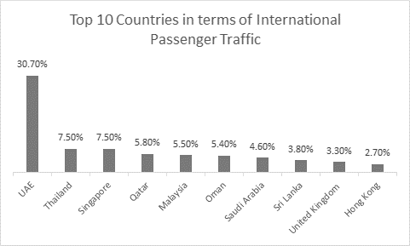

International passenger traffic to and from India
Diving into the specific countries, we see that the top 10 countries in terms of International Passenger Traffic are UAE, Thailand, Singapore, Qatar, Malaysia, Oman, Saudi Arabia, Sri Lanka, United Kingdom and Hong Kong.
According to IATA’s report on India’s Air Transport Sector dated January 15 2019, Indian air traffic would increase six-folds to 1.1 billion by 2040. It also said that the top 4 Indian Air Transport market till the year 2037 would be UAE, Saudi Arabia, Singapore and Thailand. This is due to the combined effects of increasing GDP and population of these regions, increasing trade relations between them and also due to the increasing popularity of long distance short-break connecting flights.
Team Meraki

Slide 20
Workhorses for a start up airline focusing on international routes
Airbus A321XLR
A successor of the A321neo, the XLR has an unbeatable fuel economy for flying extra long ranges - a 30% lower fuel burn as compared to the NEO.
Although a narrow-body, this would be the ideal for an international focused startup airline as, other than the added fuel economy, it has a capacity of 200 passengers(range 4,700 nmi), which means less time would be spend on the ground, due to quicker boarding and deplaning, thus reducing the airport costs.
Another advantage is that due to a small capacity, the passengers would have a more private-jet like feeling as compared to an wide-body aircraft, and a less probability of nuisance such as crying babies, farter, snorers, etc.
Indigo Group has recently ordered 50 of these to fulfill their expansion plans.
Airbus A330-300
The A330-300 is a wide-body aircraft with a passenger capacity of 300, range of 6,350 nmi.
As compared to Boeing’s 777-300, this is a better option as, although 777-300 has a greater capacity of 368 with the same range, it is costlier by $97 million.
As a startup airline, with the A330-300, it would be easier for the airlines to fill 300 rather than 368 thus making it more easier for them to break even.
To summarize the above, for a Startup Airline focusing on international routes, we suggest these two aircrafts, the A321XLR as a low-cost long range flight, while the A330-300 as a luxury aircraft, thereby catering the needs of a broad spectrum of passengers.
Team Meraki
Thank You – Team Meraki

